Slide 1
The Australian Energy Regulator
Pre-determination conference
Draft decision: TasNetworks transmission determination
11 December 2014

Slide 2
Today’s agenda
Presentations from:
AER — Chris Pattas, General Manager - Networks
Consumer Challenge Panel — Hugh Grant
TasNetworks — Lance Balcombe, CEO
Time for questions at the end of presentations
Close at 3:00 pm

Slide 3
The Australian Energy Regulator
Pre-determination conference
Draft decision: TasNetworks transmission determination
Chris Pattas, General Manager

Slide 4
About our draft decision: context and framework
Changes to the National Electricity Law and Rules in 2012
National Electricity Objective
Revenue and pricing principles
A greater role for consumers
consumer engagement
Consumer Challenge Panel
2013 Better Regulation program
New guidelines setting out our approach

Slide 5
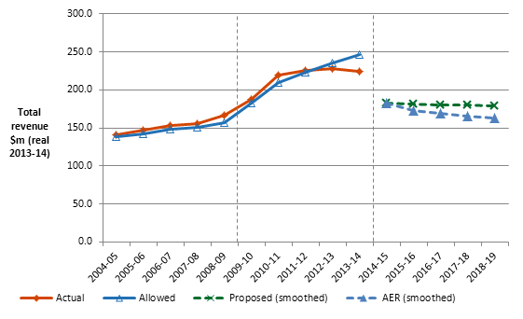
Total revenue: TasNetworks
TasNetworks’ past total revenue, proposed total revenue and AER draft decision revenue allowance ($ million, 2013–14)

Slide 6
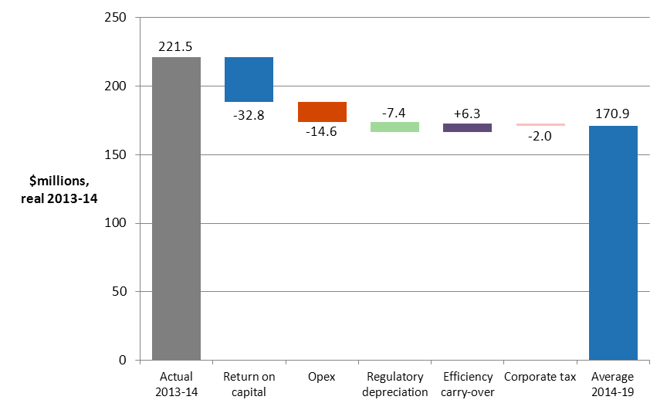
Annual revenue: Key differences between previous period and draft decision
AER's draft decision on building block costs ($ million, 2013–14)
Note: 'Actual 2013-14' is TasNetworks' latest estimate of actual revenue to be recovered for that year. To calculate building block changes, this estimate is notionally divided in the same proportion as allowed building block revenue over the 2009–14 regulatory control period.

Slide 7
Total revenue: Key differences between proposal and draft decision
7% reduction to proposed revenue (2015-19)
Rate of return:
6.88% (AER) (to be updated annually) vs. 7.58% (TasNetworks)
11% reduction to proposed capex
no reduction to proposed opex

Slide 8
Treatment of TasNetworks’ transitional year (the ‘true up’)
For TasNetworks, this regulatory period originally due to commence on 1 July 2014
The rules provided for a transitional regulatory decision to allow for an expedited transition to the new rules
Fast-tracked placeholder determination March 2014
Rules provide for ‘true-up’ as part of current determination
$9.7m (nominal) to be returned to customers over 2015-19
TasNetworks | 2014-15
AER draft decision – notional MAR | 177.2
AER transitional decision – placeholder revenue | 186.9
Difference | –9.7

Slide 9
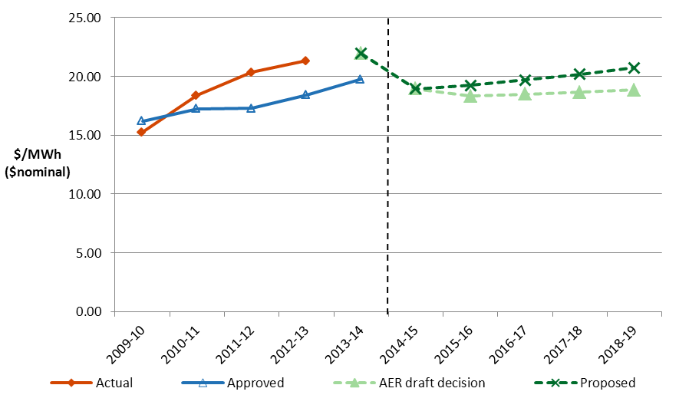
Indicative transmission charges
Average transmission charges are forecast to decrease from ~$21.90 per MWh in 2013-14 to $18.80 per MWh in 2018-19 – reduction of 16.5%
Indicative transmission price path from 2009-10 to 2018-19 for Tasmania ($/MWh, nominal)

Slide 10
Total revenue and impact on price
Estimated impact on the average annual electricity bills in Tasmania over 2014-19 ($ nominal)
 | 2013–14 | 2014–15 | 2015–16 | 2016–17 | 2017–18 | 2018-19
Residential annual bill ª | 2,256 | 2,210 | 2,201 | 2,203 | 2,206 | 2,208
Annual change |  | –46 –2% | –10 –0.4% | 2 0.1% | 3 0.1% | 3 0.1%
Small business annual bill ^{b} | 3,782 | 3,705 | 3,688 | 3,692 | 3,696 | 3,701
Annual change |  | –77 –2% | –16 –0.4% | 4 0.1% | 4 0.1% | 5 0.1%

Slide 11
Key drivers
Improving financial market conditions – Previous decisions reflected uncertainty, global financial crisis. Interest rates and risk premiums are now materially lower.
Lower regulatory asset base – TasNetworks spent lower actual capex in previous period, leading to lower opening RAB for this period and lower future revenue requirements.
Capex in previous period – Asset renewal program: maintenance-intensive assets replaced with modern, less maintenance-intensive assets. Lower repex and maintenance expenditure in 2014-19.
Lower demand – System peak demand in TAS decreased in previous period, and forecast to grow this period by only 1.2 per cent annually. Two major augex projects deferred.
Efficiency improvements – due to the Aurora and Transend merger

Slide 12
AER draft decision - Rate of return (nominal)
 | 2009–14 AER decision | 2015–19 TasNetworks proposal^{(a)} | 2014–19 AER draft decision
Nominal risk-free rate (cost of equity) | 5.80% | 4.11%^{(b)} | 3.55%^{(c)}
Equity risk premium | 6.0% | 4.55%^{(d)} | 4.55%
Market risk premium | 6.0% | 6.5% | 6.5%
Equity beta | 1.0 | 0.7 | 0.7
Gamma (imputation credit) | 0.5 | 0.5 | 0.4
Gearing ratio | 60% | 60% | 60%
Inflation forecast | 2.47% | 2.52% | 2.50%
Nominal post–tax return on equity | 11.8% | 8.7% | 8.1%
Nominal pre–tax return on debt | 8.81% | 6.84% | 6.07%^{(e)}
Nominal vanilla rate of return | 10.0% | 7.58% | 6.88%
The 6.88% rate of return will be updated annually because our decision is to apply a ‘trailing average portfolio approach’ to estimating debt, which includes annual updating of the allowed return on debt.

Slide 13
Capex: TasNetworks (1)
Proposal: $275.9m ($2013-14)
Draft decision: $246.4m ($2013-14)
AER draft decision compared to TasNetworks’ past and proposed capex ($ million, 2013-14)

Slide 14
Capex: TasNetworks (2)
Reduction in augmentation expenditure due to slower demand growth, and completion of significant asset renewal in previous period
Deferral of two major augex projects:
Waddaman-Palmerston 220 kV security augmentation project
Newton-Queenstown security augmentation project
Includes replacement capex to replace ageing assets that would have otherwise been replaced as part of the deferred augmentation projects

Slide 15
Opex: TasNetworks (1)
Proposal: $218.3m ($2013-14)
Draft decision: approved
AER draft decision compared to TasNetworks’ past and proposed opex ($ million, 2013-14)

Slide 16
Opex: TasNetworks (2)
Proposed opex is ~12% lower than actual opex in previous period
Recent merger of Transend and Aurora forecast to result in cost savings and efficiency improvements
Our assessment approach:
Base-step-trend
Rate of change
Step changes
TasNetworks’ proposed opex vs. our estimate of efficient opex of a prudent operator – not materially different, therefore we approved the proposal.

Slide 17
Other elements of the draft decision
TasNetworks’ pricing methodology
Standby service arrangements for network customers
Non-locational transmission use of system (TUoS) and common transmission services

Slide 18
Next steps
Revised proposal from TasNetworks on
13 January 2015
Stakeholder submissions by
6 February 2015
Final AER decision in April 2015

