Slide 1
AER Draft Determination Forum
TransGrid’s 2018/19 – 2022/23 Revenue Determination
Tony Meehan, Executive Manager Regulation

Slide 2
Summary
AER draft decision
Challenging energy policy environment
Contingent projects
Powering Sydney’s Future
Next steps

Slide 3
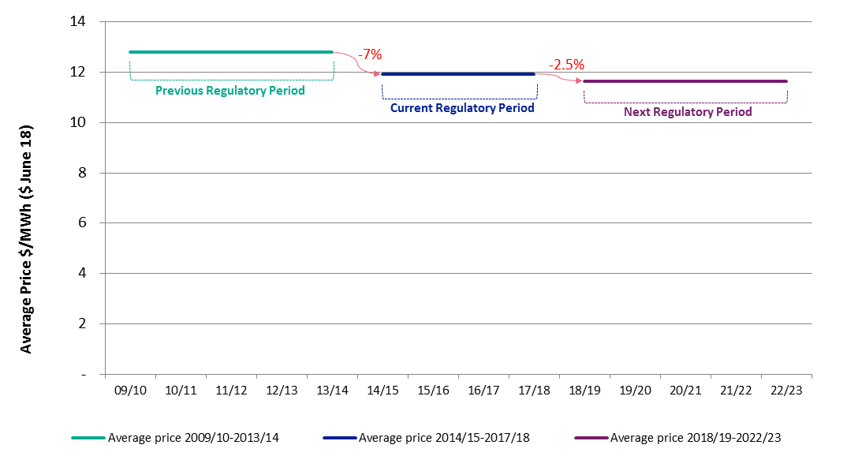
TransGrid’s revenue proposal
Average Transmission Prices 2009/10 to 2022/23
Source: TransGrid. Determined prices shown for 2009/10 to 2017/18. Forecast prices shown for 2018/19 to 2022/23

Slide 4
AER’s draft decision
Average Transmission Prices 2009/10 to 2022/23
-7%
-5%
Previous Regulatory Period
Current Regulatory Period
AER Draft Decision
Source: TransGrid. Determined prices shown for 2009/10 to 2017/18. AER Draft Decision prices shown for 2018/19 to 2022/23

Slide 5
Challenging energy policy environment
The energy environment and regulatory landscape have changed since TransGrid lodged its revenue proposal in January 2017
Changes to energy environment
February 10 energy event in NSW with mandatory load shedding
Feasibility study for additions to the Snowy Hydro scheme by the Federal Government
AEMC System Security Market Frameworks Review Final Report, advocating greater role for Transmission Networks regarding system security
AEMO Forecast higher growth in maximum demand than in previous years
COAG adopt the majority of recommendations of the Independent Review into the Future of the National Electricity Market, led by Professor Finkel, including an integrated grid plan

Slide 6
Managing the transition to renewable sources of energy
We are witnessing Australian governments acting unilaterally in establishing targets to entice renewable generation
NSW has not currently announced plans for a CET but has expressed a desire to attract renewable generation to the state
Without forward planning for the grid, NSW is at risk of not being able to support the connection of renewable generation
TransGrid as the jurisdictional planner for NSW has an obligation to ensure its grid is ready to meet the state’s future needs and keep NSW competitive in the emerging energy environment

Slide 7
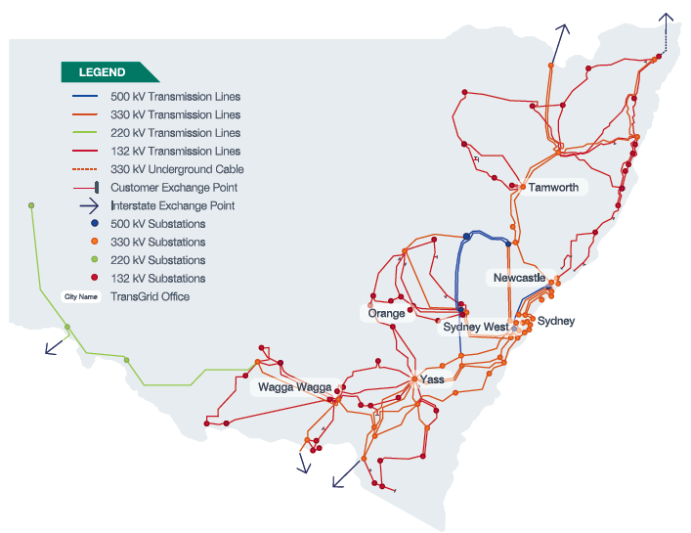
Constraints on the current network
Constraints on TransGrid’s network are continuing to limit connection of new generation to the grid
This prevents competition that could put downward pressure on wholesale prices
TransGrid has included a number of contingent projects in its submission to provide pathways in the next regulatory period, if they are needed
E.g. Support South Western NSW for Renewables; Reinforcement of Northern Network

Slide 8
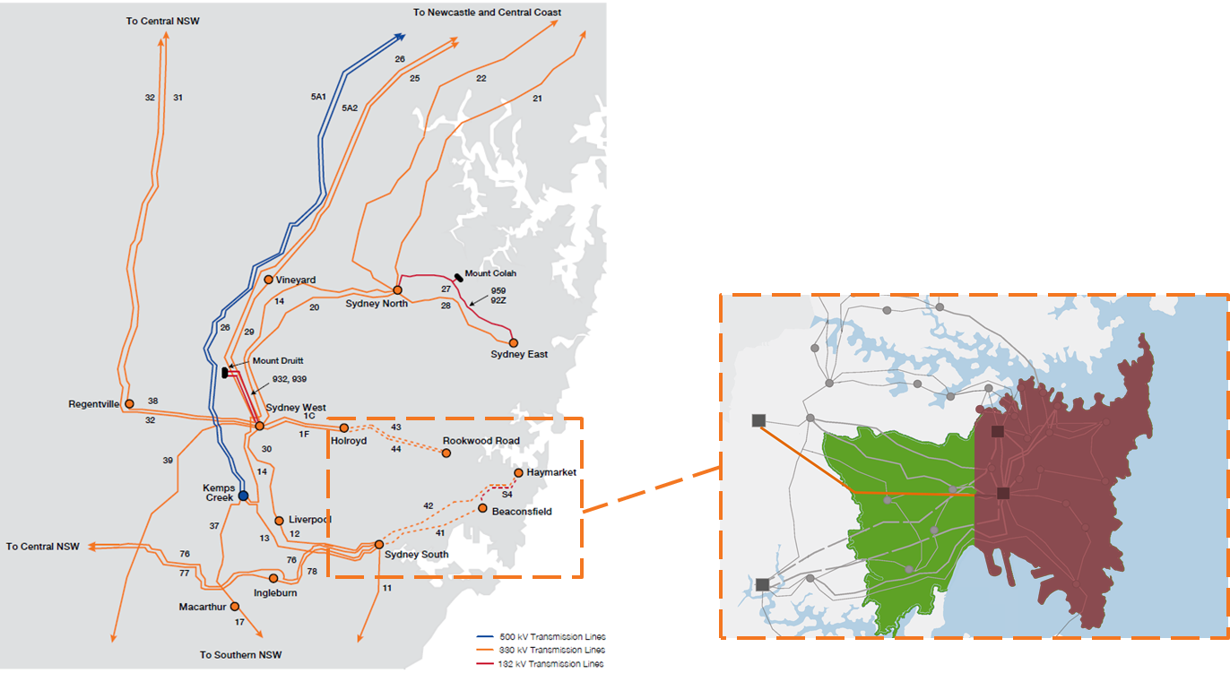
Powering Sydney’s Future
Inner Sydney transmission network supplies electricity to more than 500,000 customers in the CBD and surrounding areas
Many of the transmission assets were built in the 1960s and 1970s and are nearing the end of their serviceable life
Bondi
Sydney Airport
Note.
Red shading reflects area supplied by current Ausgrid cables proposed to be replaced under the Powering Sydney’s Future project
Hurstville

Slide 9
Powering Sydney’s Future
“We believe that reinforcing the electricity supply to the Sydney CBD is vital if we are to avoid an unacceptable risk of extended power interruption”.
– TransGrid Revenue Proposal 2018/19 – 2022/23
The electricity supply to Inner Sydney and the CBD is at risk
Aging assets
The electricity network that supplies Inner Sydney is a complex network of assets, many of which were built in the 1960s and 1970s
Deteriorating Assets
The current assets supporting the CBD and Inner Sydney are deteriorating and are at increasing risk of failure
Increasing Peak Demand
Demand in the CBD and Inner Sydney is growing, driven by an increase in dwellings and major infrastructure such as the Light Rail and WestConnex projects
Reliability
A solution is needed by 2022 to secure the reliability of supply to Australia’s largest city

Slide 10
Next steps in consultation
TransGrid will continue to consult on its Revenue Proposal
Revenue Proposal Working Group
TransGrid Advisory Council
Review of the AER draft decision and consideration of a revised proposal

Slide 11
TransGrid’s 2018/19 – 2022/23 Revenue Determination
Tony Meehan, Executive Manager Regulation

