Slide 1
Revenue Proposal
Public Forum
10 July 2014
Peter McIntyre
Managing Director
Tony Meehan
Executive General Manager

Slide 2
Outline
A changing world
Priced in the interests of consumers
Informed by consumers
Proposed revenue
Proposed capital expenditure
Proposed operating expenditure
Proposed rate of return
Other elements of the proposal

Slide 3
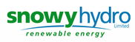









The Role of Transmission
Generation Transmission Distribution Retail Consumers

Slide 4
A Changing World
In the last five years we have seen:
  The global financial crisis
  Challenging conditions for Australian manufacturing
  Introduction of solar bonus schemes
  Greater take-up of energy efficiency initiatives
  Softening demand
TransGrid has:
  Deferred over $600 million of capital expenditure
  Changed its network investment process
  Procured demand management
  Achieved business efficiencies

Slide 5
Changes in Revenue (incl Inflation)

Slide 6
NEM TNSP Price Comparison

Slide 7
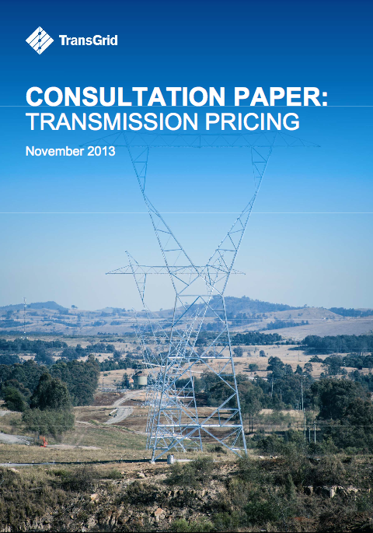
Pricing Consultation
Public consultation process
Proposed changes to pricing methodology
  Focus on peak demand
  Explore pricing certainty
  Improve cost reflective pricing
  Flexibility to amend pricing methodology

Slide 8
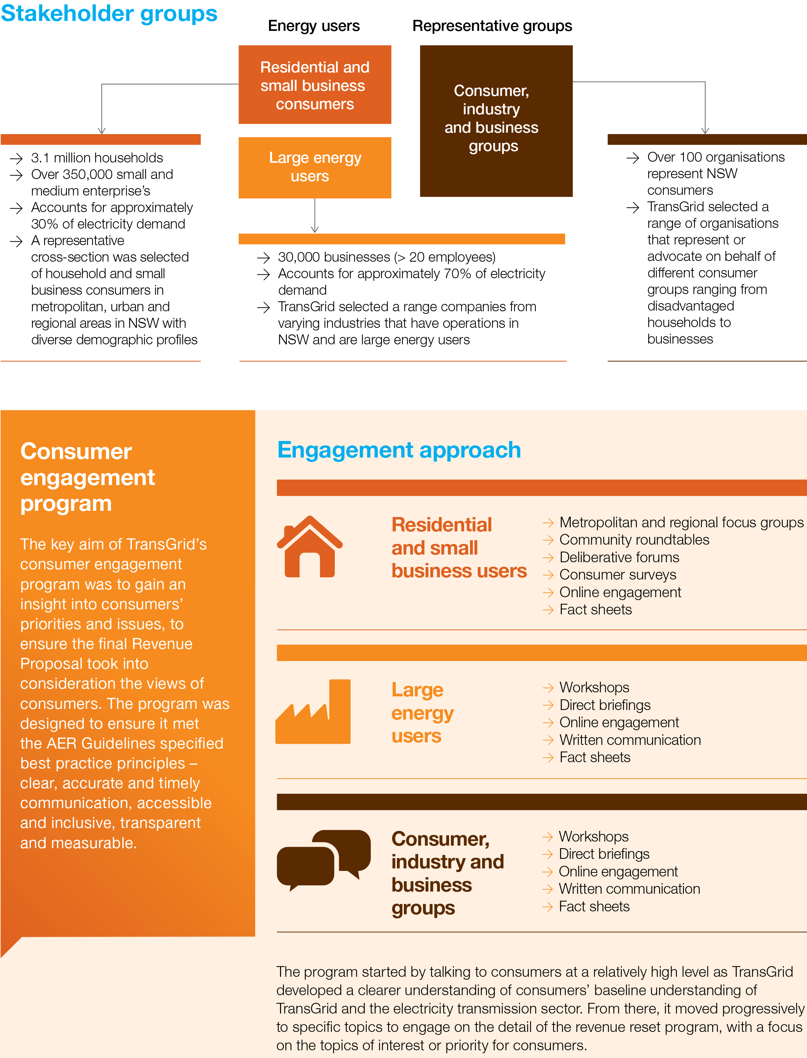
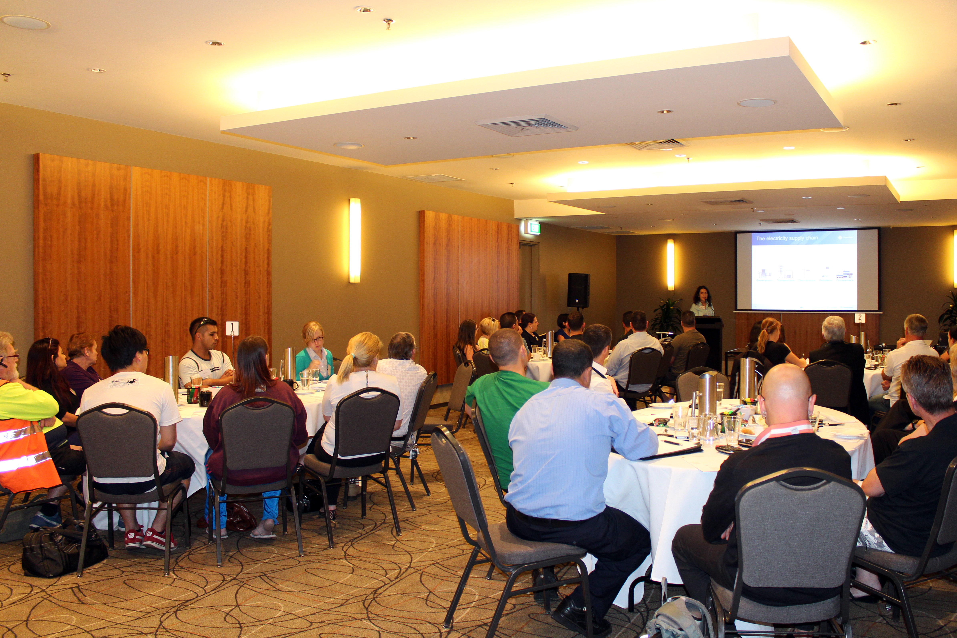
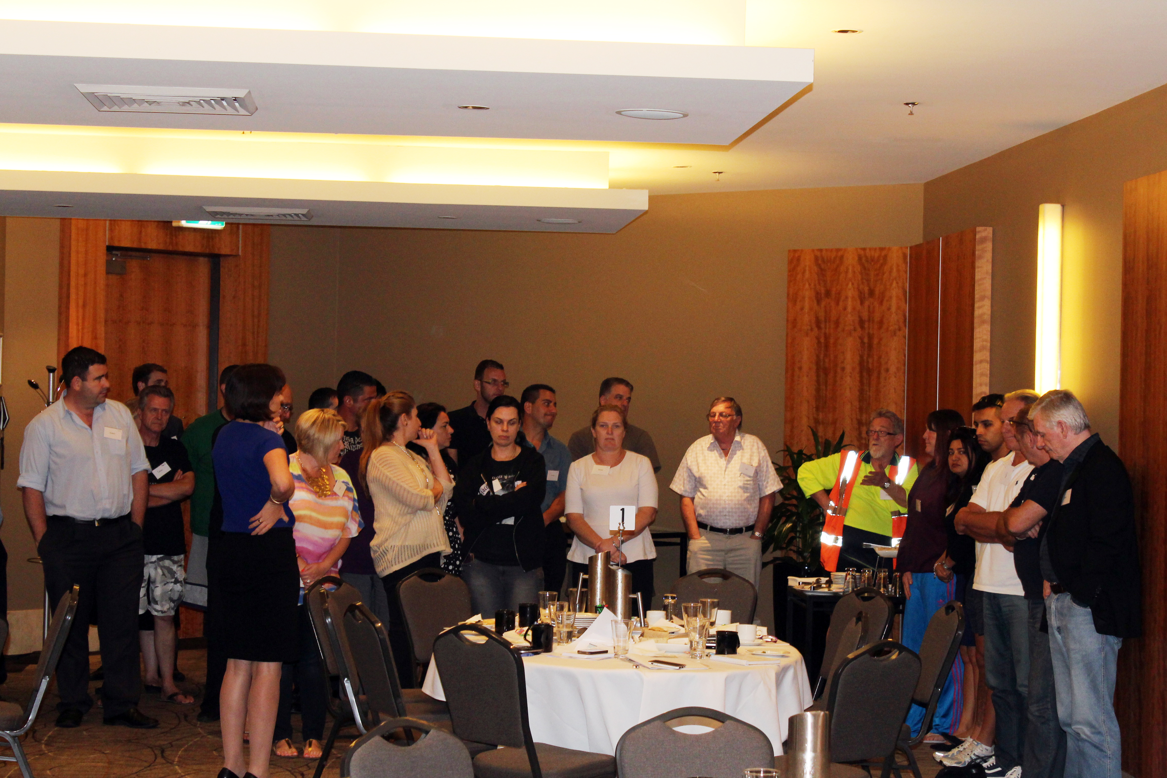
Consumer Engagement

Slide 9
In the Interests of Consumers

Slide 10
Consumer Feedback
“
The customer engagement process you provide is second to none in the country. Well done.
Excellent
”
Fair
(Consumer Advisory Representative, Mar 2014)
“
The interest in genuine discussion of the issues of each of the participants.
”
(Consumer Advisory Representative, Nov 2014)

Slide 11
Revenue (excl Inflation)

Slide 12
Capital Expenditure (excl Inflation)

Slide 13
Condition Based Replacement
TransGrid replaces assets based on condition
Each project has a detailed business case
  Condition assessment
  Condition-based risk quantification
  Option identification
  Option scoping
  Economic evaluation to select the most efficient feasible option
Low-cost alternatives to replacement
  Changes to network configuration
  De-rating of equipment

Slide 14
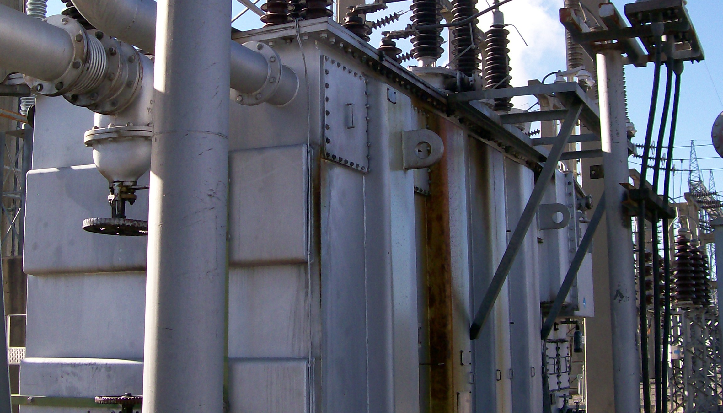
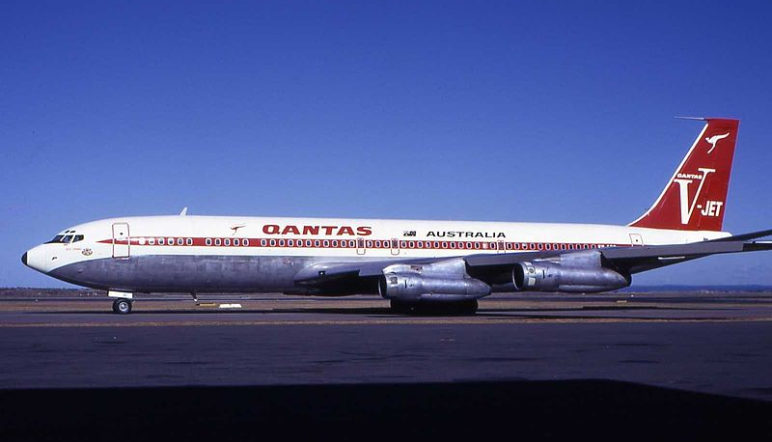
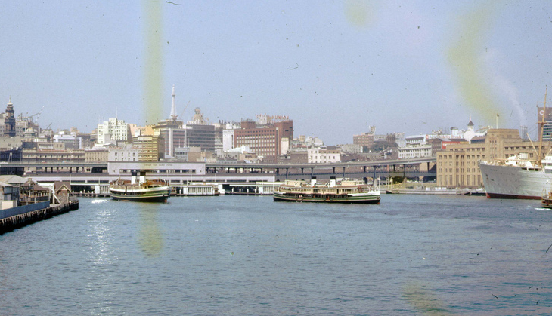
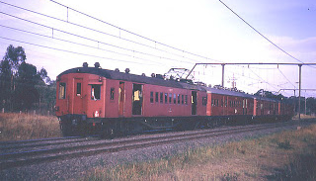
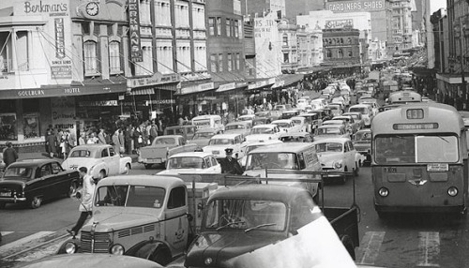
Condition Based Replacement

Slide 15
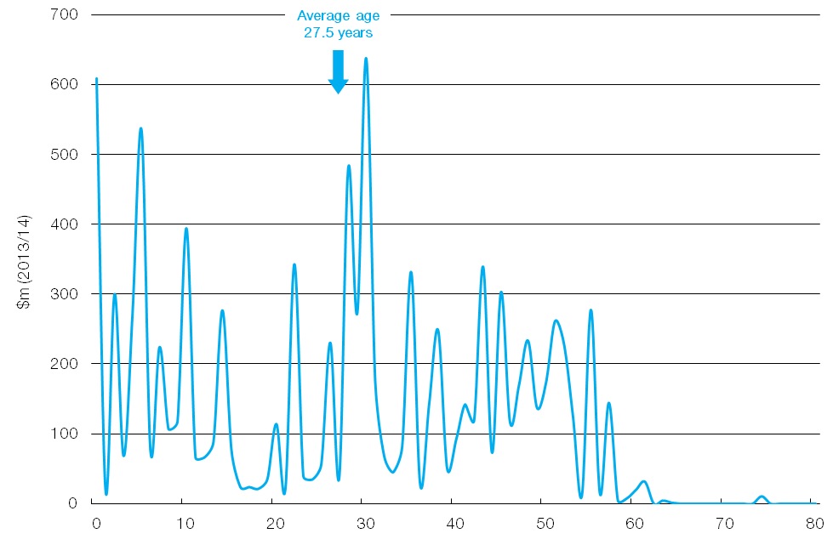
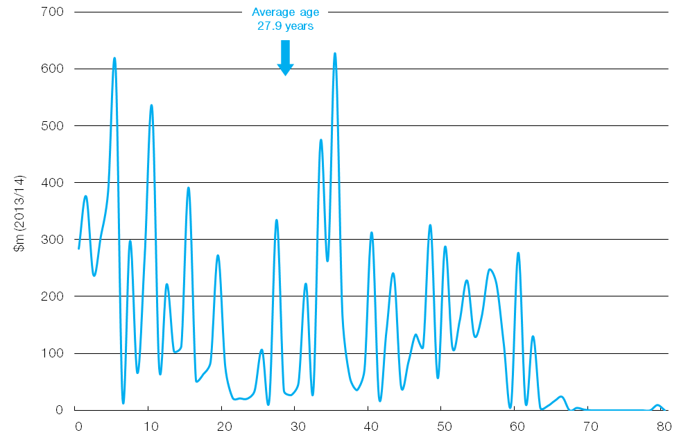
Effect of Replacement on Age
June 2014
June 2019

Slide 16
Levels of Replacement Expenditure

Slide 17
Levels of Replacement Expenditure

Slide 18
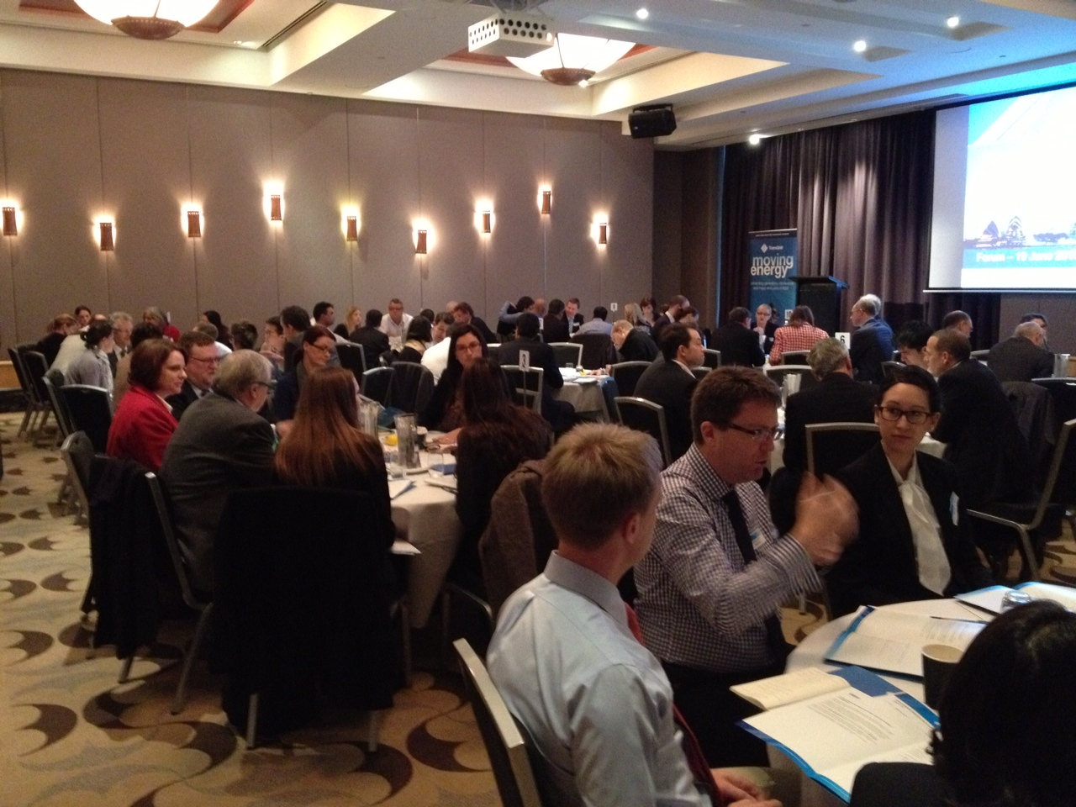
Consultation on Capital Expenditure
Powering Sydney’s Future
  Community views on need
  Demographic trends
  Energy efficiency
  Reliability standards
  Condition risk of existing
  cable network
Revenue proposal
  Demand response to defer capital network investment
  Contingent project to trigger network investment if needed

Slide 19
Operating Expenditure (excl Inflation)

Slide 20
Efficient Operating Expenditure
Health, safety & environment 2%
Higher than average benchmark
Asset management, planning & 39%
corporate services
About the same as average benchmark
Maintenance & information 59%
technology
Lower than average benchmark

Slide 21
Proposed Cost of Debt

Slide 22
Proposed Cost of Equity

Slide 23
AER Guideline on Cost of Equity

Slide 24
Other Elements of the Proposal
Incentive schemes
  Efficiency benefit sharing scheme
  Capital expenditure sharing scheme
  Service target performance incentive scheme
Proposed four year regulatory control period
  Would facilitate alignment of TNSP regulatory control periods by 2022

Slide 25

Other Elements

