Slide 1
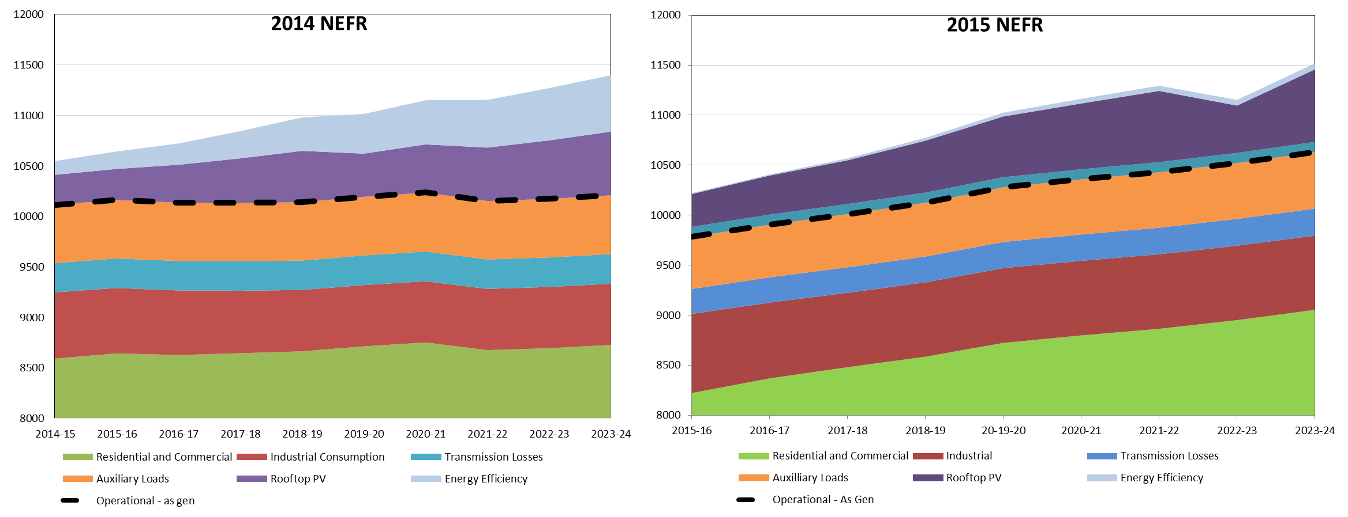
2014 NEFR vs. 2015 NEFR
The Energy Efficiency over-estimation in AEMO’s 2014 NEFR (that we challenged in our EDPR proposal) has now been corrected – now growth !!
A new problem in the 2015 NEFR with the launch point. Seems to be a problem with weather correction – 500MW reduction in load !!
This has completely disappeared in 2015 NEFR!!
Energy Efficiency forced zero growth forecast in 2014 NEFR
AEMO now presenting growth !!
But why launch point so much lower than 2014 NEFR ??

Slide 2
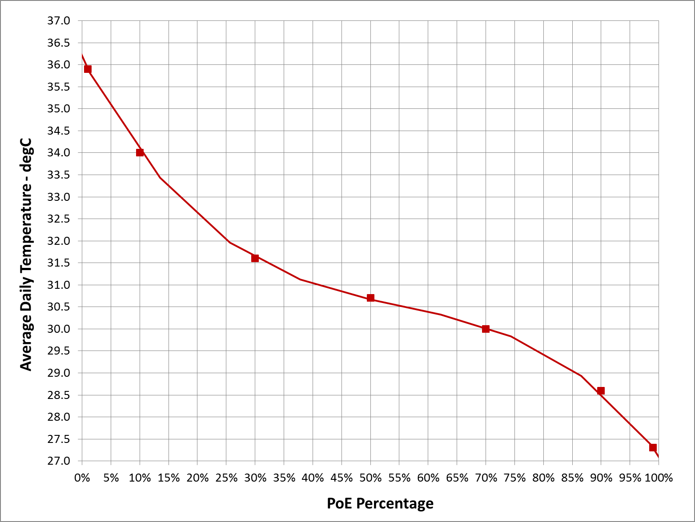
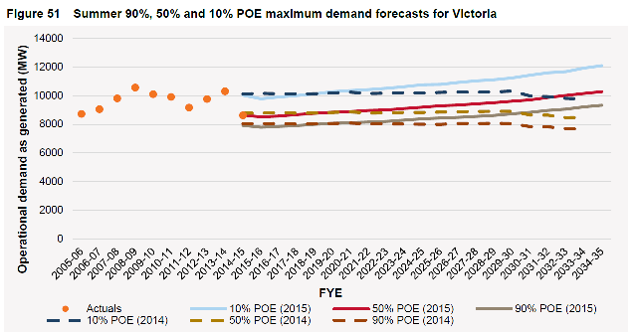
Launch Point Issue
Vic. maximum demand for 2014/15 occurred on 22nd Jan 2015
Max = 35.8C, Min = 18.7C, Avg = 27.2C. This is a 99% PoE summer !!
AEMO’s 90% PoE forecast should be above last summer’s actual
AEMO appear to have assumed 50% PoE
Historical temperature probabilities
50% PoE Forecast intersects last summer’s 99% PoE actual – this cannot occur !!
27.2 deg C corresponds to 99% PoE

Slide 3
Clarifications
Explain the reason for the changes in Energy Efficiency contribution in the forecast MDs between the 2014 and 2015 NEFRs
Explain why a 99% PoE actual MD is used as 50% PoE in the 2015 NEFR
What MD regression elasticity values have been assumed for price, economic growth and population growth (%/%), and what forecast values have been assumed for the corresponding rates (%/annum) ?
Does AEMO agree that the single largest contributor to reduced MD growth over the last five years has been retail electricity price increases ? If not, why not ?
Why are EVs not forecast over the 10-year horizon ?
Good forecasting methodologies require reconciliation of top-down forecast with bottom-up forecasts – how has AEMO done this and how have they used feedback from DNSPs ?
Established suburban areas have the largest MD reconciliation difference between UE and AEMO. How does AEMO consider in its MD forecasts
    infill developments (e.g. high rise / high density residential development) in these areas ?
    areas earmarked by Melbourne Planning Authority as National Employment Clusters ?
    areas earmarked as Principal and Major Activity Centres ?
    the reconciliation with consistently strong new connections applications (large and small)

