Slide 1
Incentives to achieve the future network and our DMIS strategy
30th July 2015
Andrew Schille and Rodney Bray

Slide 2
Overview
Part One – Stronger innovation incentives required to facilitate transition to new electricity market
Part Two – Overview of our DMIS investment over the current and upcoming regulatory periods

Slide 3
Part One

Slide 4
Future electricity market
No single view of the path to the future electricity market but change is inevitable
Will be driven by a technology changes, structural changes and customer preferences
Efficient DNSP investment is critical for transition to new electricity market
  Current Regulatory Framework does not adequately incentivize and encourage investment needed for transition
  Need an innovation scheme to drive transformation in an efficient and orderly manner

Slide 5
Future role of DNSPs
Our core functions will be to:
    Provide secure and reliable energy
    Provide a core smart grid platform
    Connect new technology
    Store energy (i.e. through solar)
    Link buyers and sellers
Future investment will include more innovative investment, including in solar and batteries, and focus on:
  Maintaining existing core network rather than building more assets to meet the peak
  Using existing assets more efficiently

Slide 6
Transitioning to the future network
Current Regulatory Framework lacks incentives to drive innovative investment required to transform the DNSPs
DMIS provides token funding limited to trials – 2011 to 2015 DMIS allowance was $2 million
Through current review of DMIS AER should increase incentives for :
  Research and development
  Smarter network investment – innovation and business improvements
  Substitution of network solutions
  Incentivize the most efficient (least cost) solution as technology evolves
  Provide value for consumers and meet their needs into the future

Slide 7
Better approach - Ofgem UK
Network Innovation Competitions (NICs) promoted electricity market transformation through:
Investment in R&D and demonstration projects - required because speculative and deliver uncertain commercial returns
Development of internal structures and third party contacts required to facilitate innovation as part of business as usual need to be supported
Three components of NIC:
Network Innovation Allowance (NIA) – funding for smaller innovation projects – part of revenue allowance
A Network Innovation Competition (NIC) – an annual competition to fund selected flagship innovative Projects
A Innovation Roll-out Mechanism (IRM) – to fund the roll-out of proven innovations

Slide 8
Part Two

Slide 9
DMIS - Strategy for the 2016-2020 period
  Build our demand management capabilities by:
      Developing additional levers for managing and influencing peak demand
      Incorporating demand management into our BAU business cases, ranking reliable demand management initiatives economically against traditional augmentations (this will include capex – opex substitution within period)
      Establishing IT systems to support the new or enhanced demand management capabilities (including integration of third parties), and to cater for increased volumes
      Demonstrating our demand management initiatives can defer network augmentation
  DMIS is only a facilitator of new DM capabilities. Our initiatives are much broader than DMIS and should be part of BAU

Slide 10
Initiatives
Type | 2011-2015 | 2016-2020
1. Tariff Based | Demand Tariff reforms | Monash Uni Dynamic Pricing
2. Residential Demand Response | Summer Saver Trial | Trial expanded to include air-con and pool pump control UE Residential DM as BAU DM IT platform for scale
3. Storage ( / Solar) | VPP Trial Economic storage deployment to 7 constrained substations BAU | Economic storage deployment to constrained substations BAU (behind the meter assets)
4. C&I Demand Response | Doncaster Hill District Energy Services | District Energy Services UE C&I DM capability as BAU
5. Electric Vehicle Charging | Vic Govt. EV Trial sites | EV controlled charging trial
6. Non-network (Third Party) Support | 1.0MW network support in Carrum 0.8MW network support in Mulgrave | Capex – Opex substitution opportunities including 9MW DM in Mornington Peninsula

Slide 11
Appendix
  2011-2015 DMIS initiatives
  2011-2015 Business as usual DM initiatives
  2016-2020 DMIS initiatives
  2016-2020 Business as usual DM initiatives

Slide 12


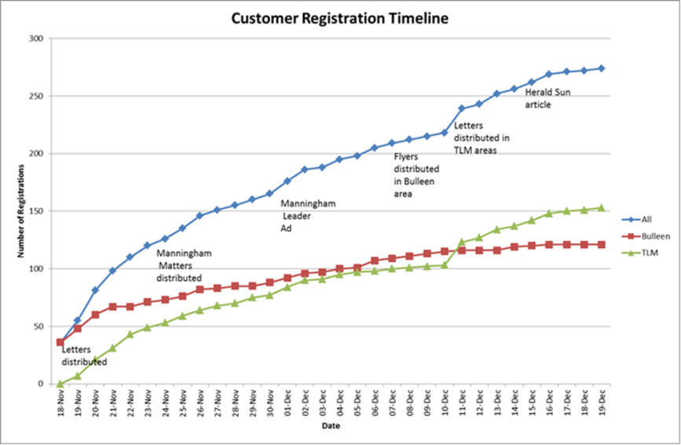
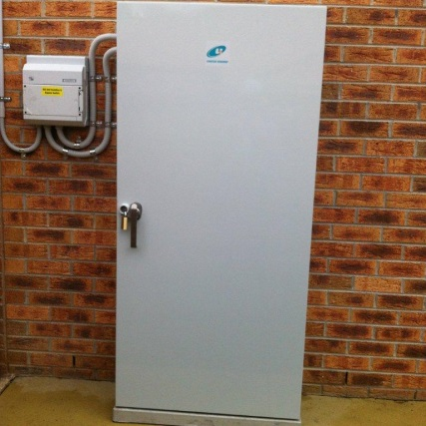
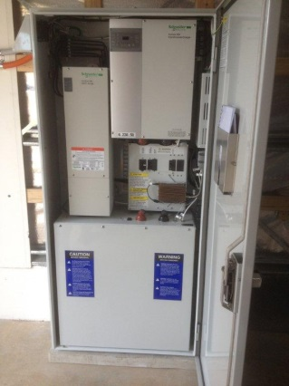
2011-2015 DMIS Initiatives
  Doncaster Hill District Energy Services Scheme (DESS)
  Virtual Power Plant (VPP) Pilot
  Bulleen Demand Response (Summer Saver) Pilot

Slide 13
2011-2015 BAU Initiatives
  2 year contract with GreenSync to provide 1MW network support services in Chelsea area
  2 non-network proposals received in response to our open Lower Mornington Peninsula RIT-D to provide 9MW of network support services
  1 non-network proposal received to provide 0.8MW network support services in Mulgrave area for next summer
  7 constrained distribution substations identified for economic deployment of storage at lower cost than network augmentation – we are now transitioning the VPP Trial from DMIS to BAU
  Demand response trials being used as a summer preparedness and contingency planning option to manage demand in our constrained low voltage networks – we are close to transitioning the Summer Saver Trial from DMIS to BAU

Slide 14
2016-2020 DMIS Initiatives
  District Energy Services Scheme – a continuation and expansion of the current project to facilitate implementation phase with non-network solutions to defer augmentations planned for the Doncaster area
  Smart Grid Activation – to trial controlled electric vehicle charging and smart appliance control
  Summer Saver Trial – a pilot to test the feasibility of UE directly controlling customer load blocks at high demand with this pilot focused on pool pump and air-conditioning control and supply capacity limiting. We also wish to expand the current pilot to increase participation volumes in readiness for BAU deployment.
  Monash University Dynamic Pricing Pilot – a joint initiative to implement dynamic pricing signals at Monash University campuses to manage the peak demands at each campus.

Slide 15
2016-2020 BAU Initiatives
  To migrate our demand management activities to BAU and cater for increased volumes of demand response customers and providers we need to establish a demand management IT platform. This platform would:
    Manage demand management programmes and enroll customers
    Manage technology deployment and devices
    Forecast and dispatch non-network solutions and demand management
    Events creation and customer notifications
    Integration of third party aggregators
    Create customer baseline calculation, performance reports & settlement data
  Tariff reforms with residential demand tariff applied
  Continue to contract third-party network support through our demand side engagement activities and develop our internal C&I DM capability
  Continue to deploy storage where economically viable to defer augmentation
  Fully transition Summer Saver to business as usual

